Slide 1

Introduction to Machine Learning
Project: Classification of heart diseases
Team members: Aru, Nurzhaussyn, Nazym

Slide 2
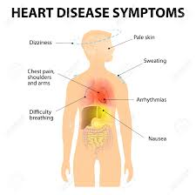
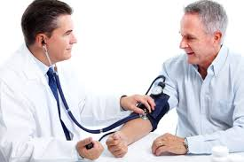
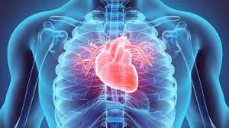
The aim of the project
“to build a model that can predict the probability of heart disease occurrence, based on a combination of features that describes the disease”

Slide 3



Dataset
Our dataset was obtained from Cleveland database. This is publicly available dataset in the Internet. The dataset shows different levels of heart disease presence from 1 to 4 and 0 for the absence of the disease. We have 303 rows of people data with 13 continuous observation of different symptoms

Slide 4
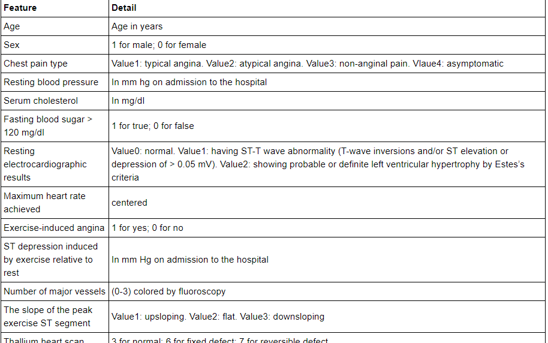
Description of the fields of dataset

Slide 5
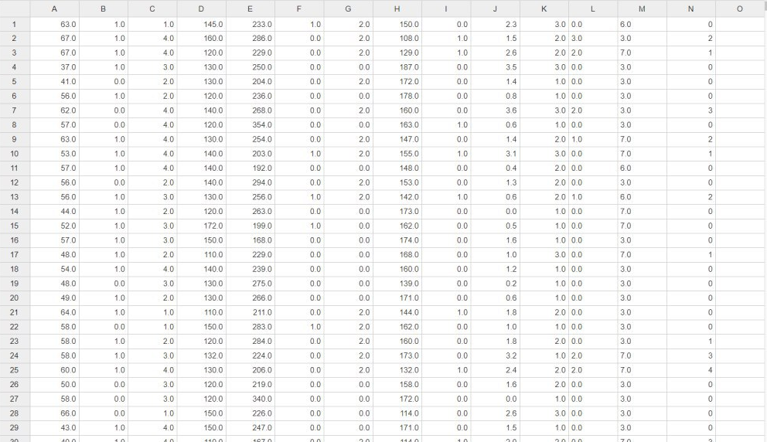
Our dataset

Slide 6
What have we done?
Read the dataset
Grouped the dataset by the number of people, made statistics for each fields of dataset
Did research for each level of heart disease: found max, min and mean values
Made assumptions for each level of heart disease
Divide the dataset into 2 groups: training and testing data
Made a relationship figure between fields of dataset and ages
Apply SGD Classifier to our dataset
Predicted the values in test dataset for diseased or not diseased
Test the values of the dataset to check them for heart disease symptoms

Slide 7

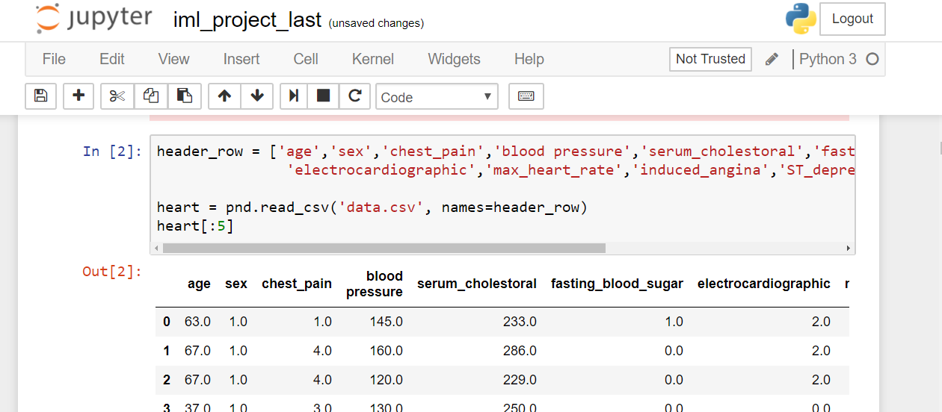
Read the dataset

Slide 8

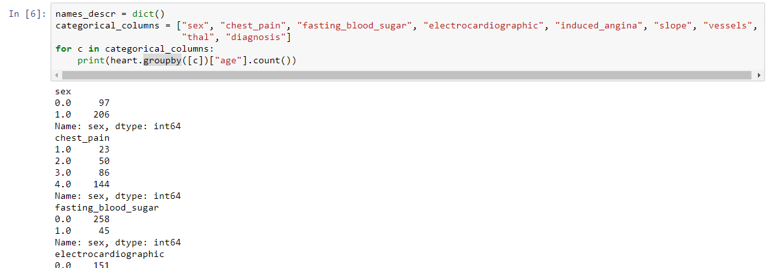
Grouped the dataset by the number of people, made statistics for each fields of dataset
Number of people

Slide 9

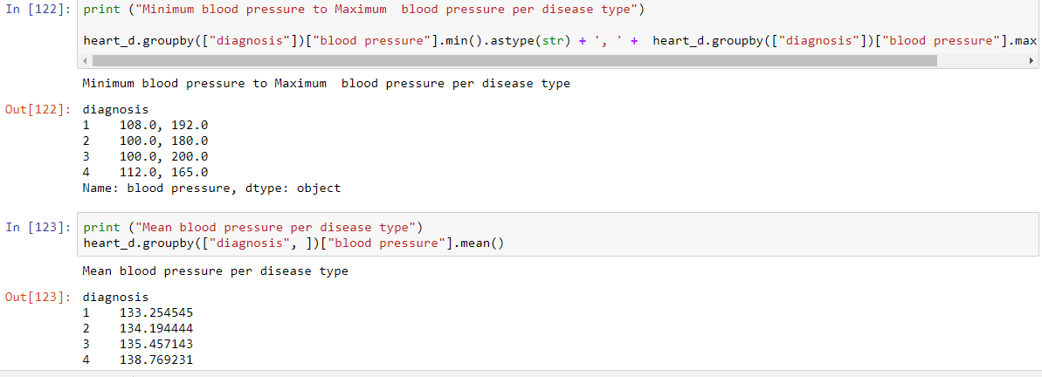
Did the research for each level of heart disease: found max, min and mean values
Levels of disease
Mean values

Slide 10

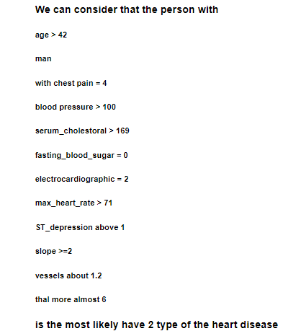
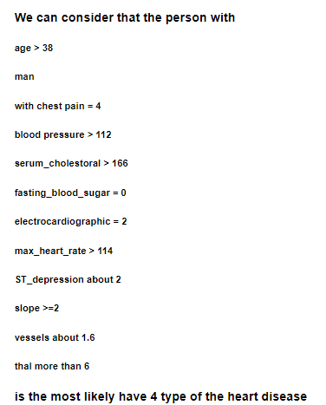
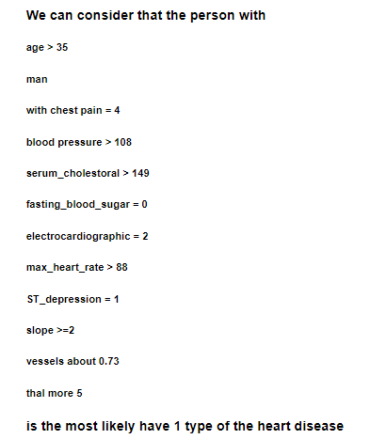
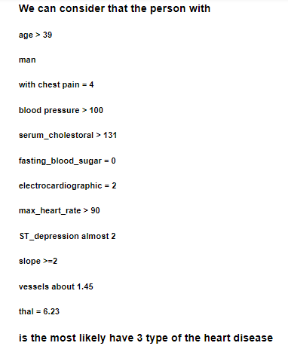
Made assumptions for each level of heart disease

Slide 11

Divide the dataset into 2 groups: training and testing data
Train
Test
203 rows
100 rows

Slide 12

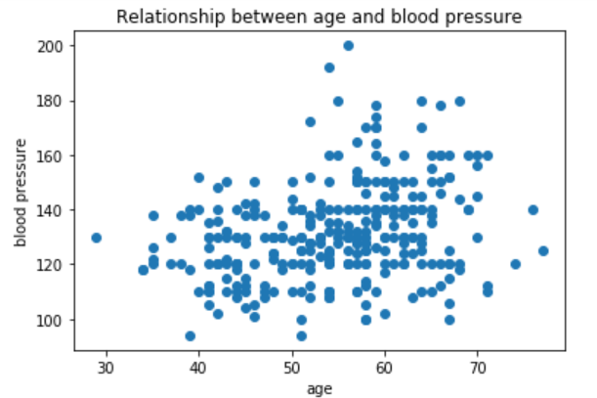
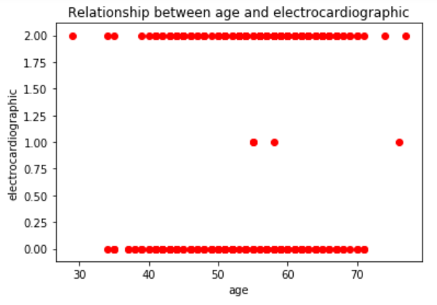
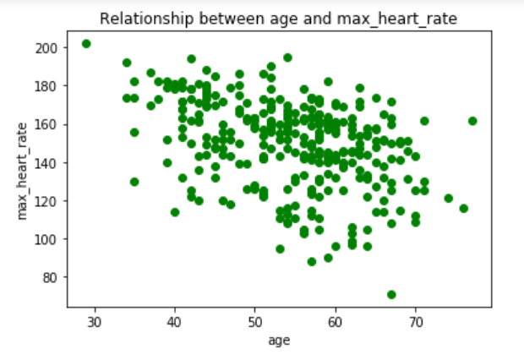
Made a relationship figure between fields of dataset and ages

Slide 13

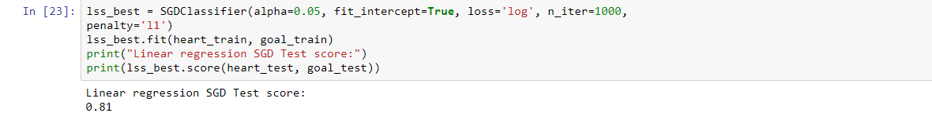
Apply SGD Classifier to our dataset

Slide 14
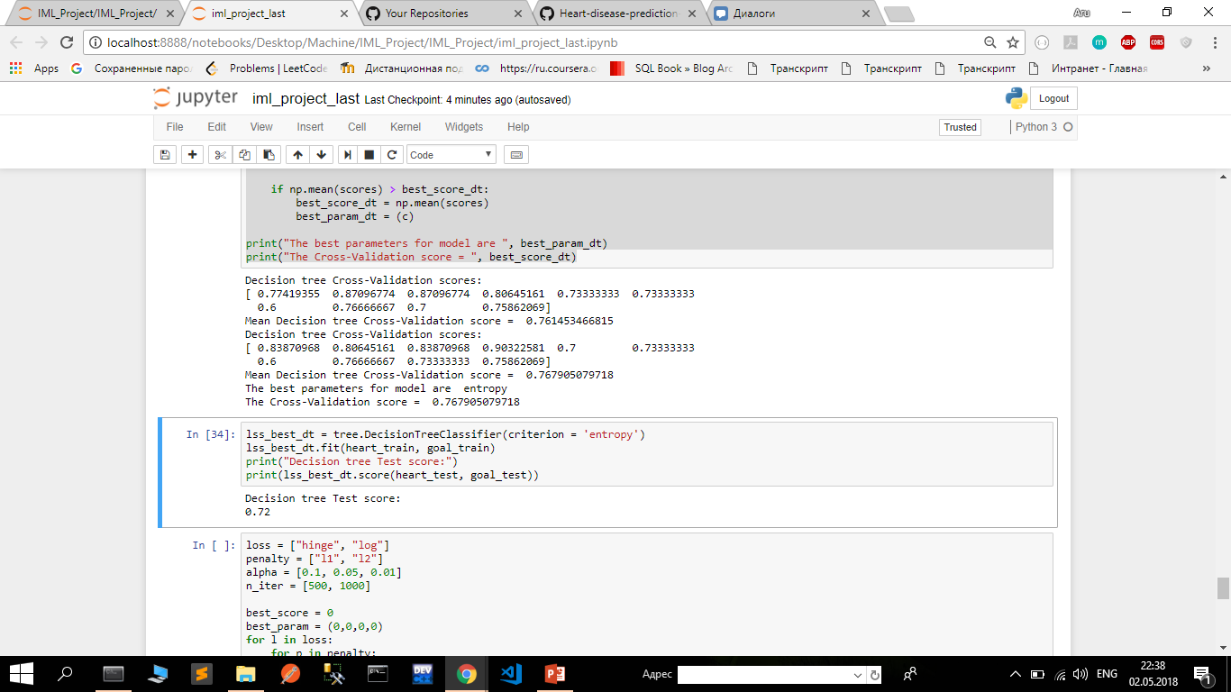
Apply Decision tree to our dataset

Slide 15

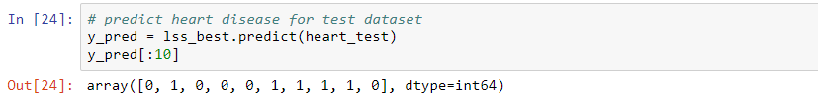
Predicted the values in test dataset for diseased or not diseased
The models are aiming to predict the probability that a given patient x will be diagnosed as heart disease, and predict the weights of the features on finding the probability.

Slide 16

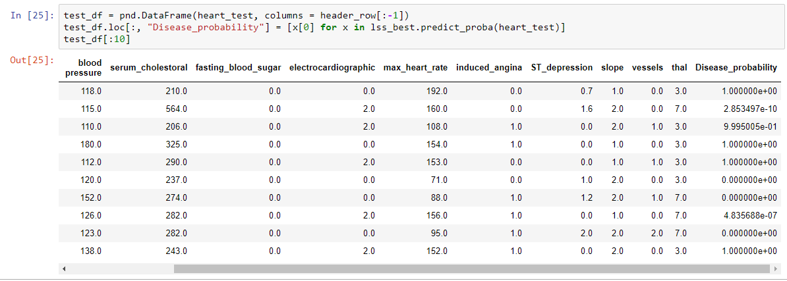
Test the values of the dataset to check them for heart disease symptoms
Probability

Slide 17



The End

